Slide 1
MA/CSSE 473 Day 36
Kruskal proof recap
Prim Data Structures and detailed algorithm.

Slide 2
Recap: MST lemma
Let G be a weighted connected graph with a MST T;
let G′ be any subgraph of T, and let C be any connected component of G′.
If we add to C an edge e=(v,w) that has minimum-weight among all edges that have one vertex in C and the other vertex not in C,
then G has an MST that contains the union of G′ and e.
[WLOG v is the vertex of e that is in C, and w is not in C]
Proof: We did it last time
Notes:
Consider doing this one on the board, and showing the slides later.
Write on board:
Graph G has MST T
G' is a subgraph of T
C is a connected component of G'
e = (v,w) = minimal-weight-edge from C to G-C.
Then do the steps

Slide 3
Recall Kruskal’s algorithm
To find a MST:
Start with a graph containing all of G’s n vertices and none of its edges.
for i = 1 to n – 1:
  Among all of G’s edges that can be added without creating a cycle, add one that has minimal weight.
Does this algorithm produce an MST for G?

Slide 4
Does Kruskal produce a MST?
Claim: After every step of Kruskal’s algorithm, we have a set of edges that is part of an MST
Base case …
Induction step:
  Induction Assumption: before adding an edge we have a subgraph of an MST
  We must show that after adding the next edge we have a subgraph of an MST
  Suppose that the most recently added edge is e = (v, w).
  Let C be the component (of the “before adding e” MST subgraph) that contains v
    Note that there must be such a component and that it is unique.
  Are all of the conditions of MST lemma met?
  Thus the new graph is a subgraph of an MST of G
Work on the quiz questions with one or two other students
Notes:
Did not do this in 201310, it was in HW 13 instread

Slide 5
Does Prim produce an MST?
Proof similar to Kruskal.
It's done in the textbook

Slide 6
Recap: Prim’s Algorithm for Minimal Spanning Tree
Start with T as a single vertex of G (which is a MST for a single-node graph).
for i = 1 to n – 1:
  Among all edges of G that connect a vertex in T to a vertex that is not yet in T, add to T a minimum-weight edge.
  At each stage, T is a MST for a connected subgraph of G. A simple idea; but how to do it efficiently?
  Many ideas in my presentation are from Johnsonbaugh, Algorithms,
  2004, Pearson/Prentice Hall

Slide 7
Main Data Structure for Prim
Start with adjacency-list representation of G
Let V be all of the vertices of G, and let V_{T} the subset consisting of the vertices that we have placed in the tree so far
We need a way to keep track of "fringe vertices"
  i.e. edges that have one vertex in V_{T}
  and the other vertex in V – V_{T}
Fringe vertices need to be ordered by edge weight
  E.g., in a priority queue
What is the most efficient way to implement a priority queue?
Notes:
Ask about what is needed before revealing any parts of this slide
A binary heap

Slide 8
Prim detailed algorithm step 1
Create an indirect minheap from the adjacency-list representation of G
  Each heap entry contains a vertex and its weight
  The vertices in the heap are those not yet in T
  Weight associated with each vertex v is the minimum weight of an edge that connects v to some vertex in T
  If there is no such edge, v's weight is infinite
    Initially all vertices except start are in heap, have infinite weight
  Vertices in the heap whose weights are not infinite are the fringe vertices
  Fringe vertices are candidates to be the next vertex (with its associated edge) added to the tree

Slide 9
Prim detailed algorithm step 2
Loop:
  Delete min weight vertex w from heap, add it to T
  We may then be able to decrease the weights
  associated with one or more vertices that are adjacent
  to w
Notes:
Ask about what is needed before revealing any parts of this slide
A binary heap

Slide 10
Indirect minheap overview
We need an operation that a standard binary heap doesn't support:
decrease(vertex, newWeight)
  Decreases the value associated with a heap element
  We also want to quickly find an element in the heap
Instead of putting vertices and associated edge weights directly in the heap:
  Put them in an array called key[]
  Put references to these keys in the heap

Slide 11
Indirect Min Heap methods
operation | description | run time
init(key) | build a MinHeap from the array of keys | Ѳ(n)
del() | delete and return the (location in key[ ] of the) minimum element | Ѳ(log n)
isIn(w) | is vertex w currently in the heap? | Ѳ(1)
keyVal(w) | The weight associated with vertex w (minimum weight of an edge from that vertex to some adjacent vertex that is in the tree). | Ѳ(1)
decrease(w, newWeight) | changes the weight associated with vertex w to newWeight (which must be smaller than w's current weight) | Ѳ(log n)

Slide 12
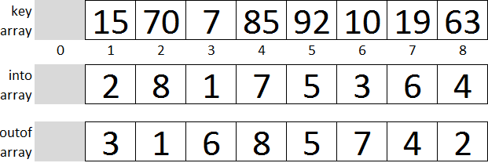
Indirect MinHeap Representation
Draw the tree diagram of the heap
outof[i] tells us which key is in location i in the heap
into[j] tells us where in the heap key[j] resides
into[outof[i]] = i, and outof[into[j]] = j.
To swap the 15 and 63 (not that we'd want to do this):
temp = outof[2]
outof[2] = outof[4]
outof[4] = temp
temp = into[outof[2]]
into[outof[2]] = into[outof[4]]
into[outof[4]] = temp

Slide 13
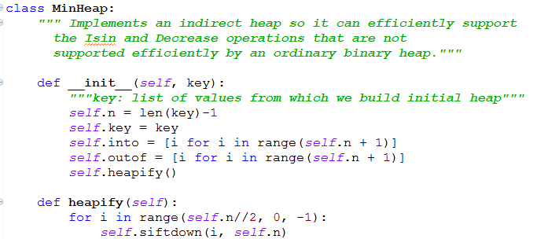
MinHeap class, part 1

Slide 14
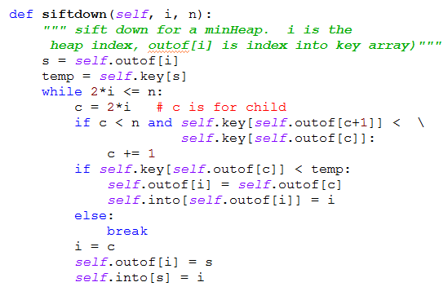
MinHeap class, part 2

Slide 15
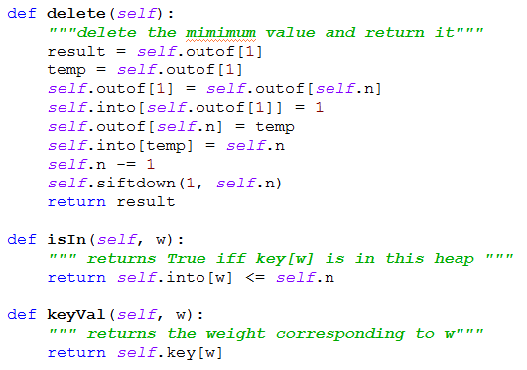
MinHeap class, part 3

Slide 16
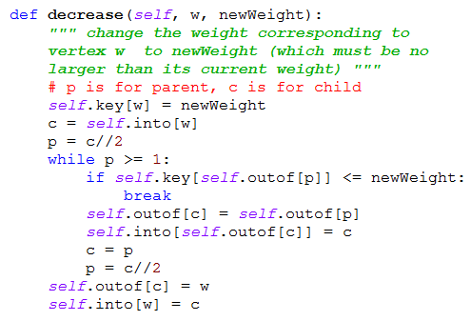
MinHeap class, part 4

Slide 17
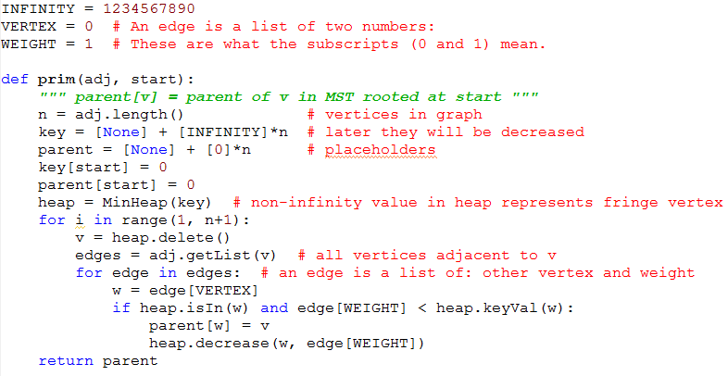
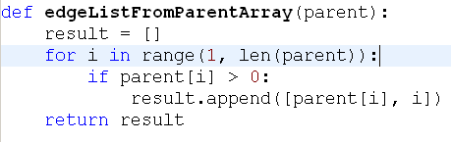
Prim Algorithm
Notes:
g = AdjancencyListGraph(
[[1, [(2, 4),(3, 2), (5, 3)]],
[2, [(1, 4), (4, 5)]],
[3, [(1, 2), (5, 6), (4, 1), (6,3)]],
[4, [(2, 5), (6,6), (3,1)]],
[5, [(1, 3), (3,6), (6,2)]],
[6, [(5, 2), (3, 3), (4, 6)]]
])
Show an example of what the parent array looks like. Draw a rootless tree on the board, number the vertices, pick a start vertex and show parent array contents.
How many total calls to inner loop execute altogether? Answer 2*|E| + |V|.
What is maximum time for a single execution of the inner loop? Answer log V
Total time is Theta((|E| + |V|) log |V|) = Theta(|E| log |V|)

Slide 18
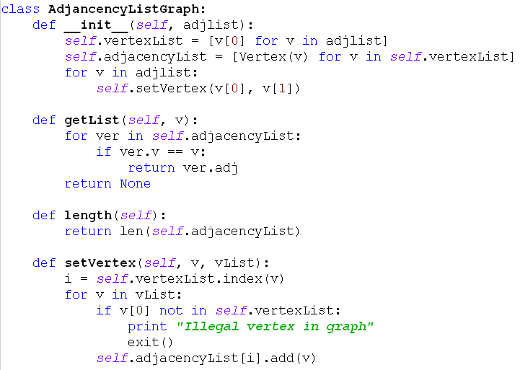
AdjacencyListGraph class

Slide 19
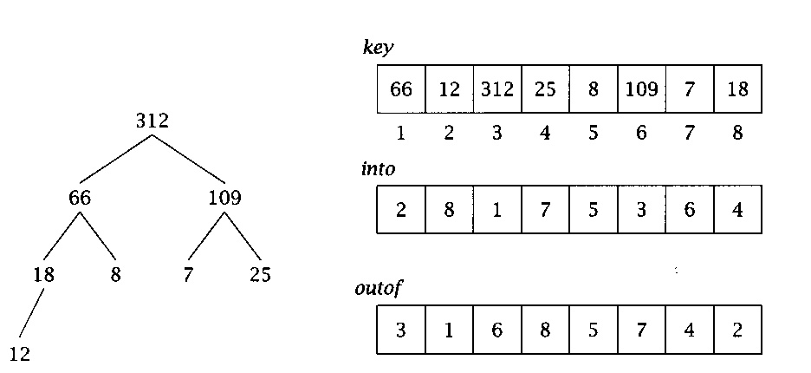
MinHeap implementation
An indirect heap. We keep the keys in place in an array, and use another array, "outof", to hold the positions of these keys within the heap.
To make lookup faster, another array, "into" tells where to find an element in the heap.
i = into[j] iff j = out of[i]
Picture shows it for a maxHeap, but the idea is the same:

Slide 20
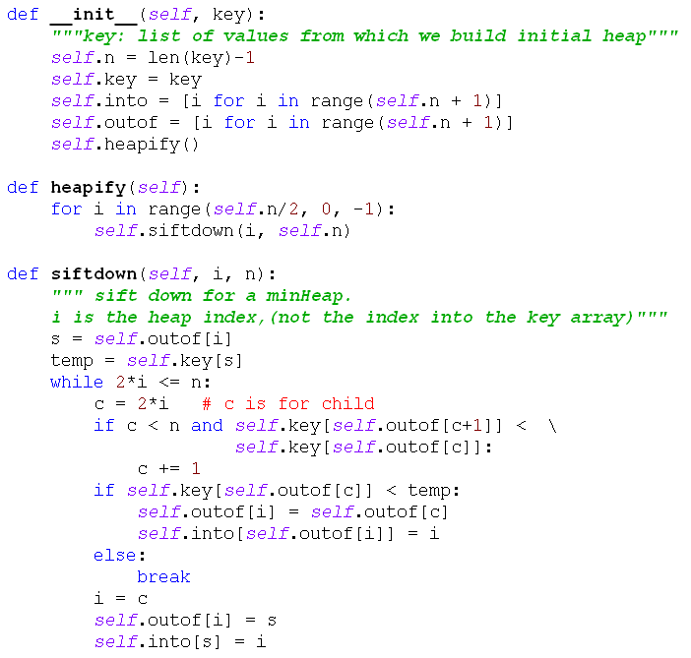
MinHeap code part 1
We will not discuss the details in class; the code is mainly here so we can look at it and see that the running times for the various methods are as advertised

Slide 21
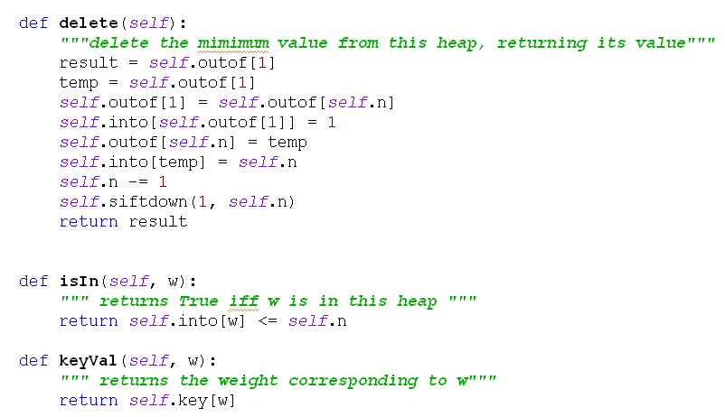
MinHeap code part 2
NOTE: delete could be simpler, but I kept pointers to the deleted nodes around, to make it easy to implement heapsort later. N calls to delete() leave the outof array in indirect reverse sorted order.

Slide 22
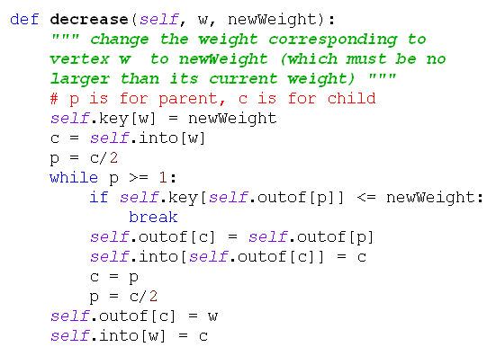
MinHeap code part 3

Slide 23
Preview: Data Structures for Kruskal
A sorted list of edges (edge list, not adjacency list)
Disjoint subsets of vertices, representing the connected components at each stage.
  Start with n subsets, each containing one vertex.
  End with one subset containing all vertices.
Disjoint Set ADT has 3 operations:
  makeset(i): creates a singleton set containing i.
  findset(i): returns a "canonical" member of its subset.
    I.e., if i and j are elements of the same subset,
    findset(i) == findset(j)
  union(i, j): merges the subsets containing i and j into a single subset.
Q37-1

Slide 24
Example of operations
makeset (1)
makeset (2)
makeset (3)
makeset (4)
makeset (5)
makeset (6)
union(4, 6)
union (1,3)
union(4, 5)
findset(2)
findset(5)
What are the sets after these operations?

Slide 25
Kruskal Algorithm
What can we say about efficiency of this algorithm (in terms of |V| and |E|)?
Assume vertices are numbered 1...n
(n = |V|)
Sort edge list by weight (increasing order)
for i = 1..n: makeset(i)
i, count, tree = 1, 0, []
while count < n-1:
if findset(edgelist[i].v) !=
findset(edgelist[i].w):
tree += [edgelist[i]]
count += 1
union(edgelist[i].v, edgelist[i].w)
i += 1
return tree

Slide 26
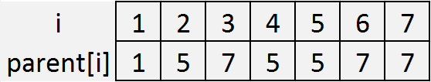
Set Representation
Each disjoint set is a tree, with the "marked" element as its root
Efficient representation of the trees:
  an array called parent
  parent[i] contains the index of i’s parent.
  If i is a root, parent[i]=i
5
1
7
2
4
3
6
8

Slide 27
Using this representation
makeset(i):
findset(i):
mergetrees(i,j):
  assume that i and j are the marked elements from different sets.
union(i,j):
  assume that i and j are elements from different sets
Notes:
Animated slide. Figure each out together before revealing it
def makeset1(i):
parent[i] = i
def findset1(i):
while i != parent[i]:
i = parent[i]
return i
def mergetrees1(i,j):
parent[i] = j
def mergetrees1(i,j):
parent[i] = j

Slide 28
Analysis
Assume that we are going to do n makeset operations followed by m union/find operations
time for makeset?
worst case time for findset?
worst case time for union?
Worst case for all m union/find operations?
worst case for total?
What if m < n?
Write the formula to use min
Notes:
n makeset calls, time n
findset worst case: n, union calls findset twice, so O(n)
Worst case for total: n + nm
If m<n, max height of trees is m, so O(n + m²)
In general, O(n + m * min(n,m))
If we can keep the trees from getting so tall, perhaps we can do better.
How can we do that?

Slide 29
Can we keep the trees from growing so fast?
Make the shorter tree the child of the taller one
What do we need to add to the representation?
rewrite makeset, mergetrees
findset & union
are unchanged.
What can we say about the maximum height
of a k-node tree?
Q37-5
Notes:
Before revealing code: We need to add a height array
Write makeset2 and mergetrees2 on the board together.
def makeset2(i):
parent[i] = i
height[i] = 0
def mergetrees2(i,j):
if height[i] < height[j]):
parent[i] = j
elif height[i] > height[j]:
parent[j] = i
else:
parent[i] = j
height[j] = height[j] + 1

Slide 30
Theorem: max height of a k-node tree T produced by these algorithms is ⎣lg k⎦
Base case…
Induction hypothesis…
Induction step:
  Let T be a k-node tree
  T is the union of two trees:
  T₁ with k₁ nodes and height h₁
  T₂ with k₂ nodes and height h₂
  What can we say about the heights of these trees?
  Case 1: h₁≠h₂. Height of T is
  Case 2: h₁=h₂. WLOG Assume k₁≥k₂. Then k₂≤k/2. Height of tree is 1 + h2 ≤ …
Q37-5
Notes:
Base case: k=1.
Induction hypothesis: For all p< k, the height of a p-node tree is at most ⎣lg p⎦.
Since k > 1, T must be the union of two trees
Case 1: height of T is max {h1, h2} <= max {⎣lg k₁⎦, ⎣lg k₂⎦ } <= ⎣lg k⎦
Case 2: 1 + h2 <= 1 + ⎣lg k₂⎦ <= 1 + ⎣lg k/2⎦ = 1 + ⎣lg k - 1⎦ = ⎣lg k⎦

Slide 31
Worst-case running time
Again, assume n makeset operations, followed by m union/find operations.
If m > n
If m < n
Notes:
n makesets are still n
union and find are m* log n
Altogether n + m log n
If m < n, we can reduce it to n + m log m

Slide 32
Speed it up a little more
Path compression: Whenever we do a findset operation, change the parent pointer of each node that we pass through on the way to the root so that it now points directly to the root.
Replace the height array by a rank array, since it now is only an upper bound for the height.
Look at makeset, findset, mergetrees (on next slides)

Slide 33
Makeset
This algorithm represents the set {i} as a one-node tree and initializes its rank to 0.
def makeset3(i):
parent[i] = i
rank[i] = 0

Slide 34
Findset
This algorithm returns the root of the tree to which i belongs and makes every node on the path from i to the root (except the root itself) a child of the root.
def findset(i):
root = i
while root != parent[root]:
root = parent[root]
j = parent[i]
while j != root:
parent[i] = root
i = j
j = parent[i]
return root

Slide 35
Mergetrees
This algorithm receives as input the roots of two distinct trees and combines them by making the root of the tree of smaller rank a child of the other root. If the trees have the same rank, we arbitrarily make the root of the first tree a child of the other root.
def mergetrees(i,j) :
if rank[i] < rank[j]:
parent[i] = j
elif rank[i] > rank[j]:
parent[j] = i
else:
parent[i] = j
rank[j] = rank[j] + 1

Slide 36
Analysis
It's complicated!
R.E. Tarjan proved (1975)*:
  Let t = m + n
  Worst case running time is Ѳ(t α(t, n)), where
  α is a function with an extremely slow growth rate.
  Tarjan's α:
  α(t, n) ≤ 4 for all n ≤ 10¹⁹⁷²⁸
Thus the amortized time for each operation is essentially constant time.
* According to Algorithms by R. Johnsonbaugh and M. Schaefer, 2004, Prentice-Hall, pages 160-161

